Slide 1
UHV-I Session 4 Program for Fulfilment of Basic Human Aspiration
Shifting from excitement to happiness…

Slide 2
Interaction Before Main Session
Hear from participants about their exploration from previous day(s)
Q&A
Place some expected conclusions, find out if they also came to these/similar conclusions

Slide 3
Home Assignment 3.1
Take your list of aspirations + concerns (from session 1 home assignment).
Find out what your aspiration or concern is closely related to:
– right understanding – relationship (right feeling) – physical facility (money, mobile, food, clothes…)
To be more clear, you may evaluate the purpose, i.e., why you want to fulfil that aspiration or resolve that concern
eg. Aspiration/Concern Purpose Right Und Relationship Physical facility
Money To buy things 
Name, fame, attention To relate to others 
Food For Body 
Latest bike For friendship 
Peace of mind For Self 
Getting rid of anger For Self 
Good health For Body 
Note: for different people, the same aspiration/concern may have a different purpose
Notes:
This assignment is to draw attention to the 3 distinct realities that are required to fulfil our aspirations and resolve our concerns

Slide 4
Could you conclude…
There are 3 basic requirements of a human being
Right understanding, fulfilment in relationship and physical facility
and not just physical facility
Our aspirations may be closely related to any of right understanding, fulfilment in relationship and physical facility
But to fulfil the basic aspiration (of happiness and prosperity in continuity), right understanding comes as the first priority
e.g., the latest bike may help you make a large circle of friends for you
But mutual happiness with friends will take place only with right understanding
Without right understanding, it may lead to competition, jealousy…
Keep exploring this for all your aspirations and concerns
Can you see that for the fulfillment of your basic aspiration (of happiness and prosperity in continuity), right understanding is essential and comes as the first priority

Slide 5
Home Assignment 3.2
Find out how much time and effort you put in every day in these 3 areas
other than for sleeping (say 8 hours)
e.g.,
Effort and Time Related to Time
Self-introspection Right understanding 1 hr
Academics Physical Facility 4 hrs
Eating, Exercise Physical Facility 2 hrs
Entertainment Physical Facility 2 hrs
Fruitful time with friends Relationship 2 hrs
Fruitful time with family Relationship 2 hrs
Any Other activity … 3 hrs
Thus: Right Understanding: 1 hrs
Relationship: 4 hrs
Physical Facility: 8 hrs
?? 3 hrs Total: 16 hours (+ 8 hours for sleeping)
Like this, you can make an overall assessment of how you are spending time every day, and see if it is ensuring the feeling of happiness and prosperity within you or not. If not, you may need to work on your schedule.
Notes:
The idea of this assignment is to see if our effort for right understanding and right feeling is in line with fulfilling the need for happiness and relationship

Slide 6
Recap: Basic Human Aspiration and Program for its Fulfilment
PROGRAM:
Understanding Harmony
RIGHT UNDERSTANDING
(le>)
in the self
Understanding Harmony:
Harmony in Human Being
Harmony in Family
Harmony in Society
Harmony in Nature/Existence
VALUES
1
Education –
Understanding
2
3
RELATIONSHIP (laca/k)
with human being
PHYSICAL FACILITY
(lqfo/kk)
with rest of nature
Living in Harmony
all 4 levels:
Individual
Family
Society
Nature/Existence
SKILLS
Sanskar –
Living
Living in Harmony
with human being
Living in Harmony
with rest of nature
MUTUAL HAPPINESS
(mHk; lq[k)
MUTUAL PROSPERITY
(mHk; le`f))

Slide 7
UHV-I Session 4 Program for Fulfilment of Basic Human Aspiration
Shifting from excitement to happiness…

Slide 8

Process of Self-exploration
Whatever is stated is a Proposal
Verify it on your own right
(Do not assume it to be true/ false)
Proposal
1
2
Verify
on the basis
Of
your
Natural
Acceptance
Experiential Validation
Live according to it
2a
2b
Behaviour with
Human Beings
Work with
Rest of Nature
Mutual Happiness
Mutual Prosperity
Which process is Naturally Acceptable to you?
A process of self-exploration, self-verification on your own right,
leading to understanding in yourself
or
A process of do’s & don’ts, in which you assume what is said, without verification
RIGHT
UNDERSTANDING

Slide 9
Happiness
Unhappiness
The state or situation*, in which I live,
if there is harmony / synergy in it,
then it is Naturally Acceptable to me to be in that state / situation
(and I want to continue to be in that state / situation)
To be in a state / situation which is Naturally Acceptable is Happiness
To be in a state of Harmony / Synergy is Happiness
Happiness = To be in Harmony
* internal state, external situation
The state or situation, in which I live,
if there is disharmony / contradiction in it,
then it is not Naturally Acceptable to me to be in that state / situation
T(and I want to get out from that state / situation)o be forced to be in a state / situation which is not Naturally Acceptable is Unhappiness
To be forced to be in a state of Disharmony / Contradiction is Unhappiness
Unhappiness = Disharmony

Slide 10
Happiness (Lkq[k)
Happiness = To be in a state of Harmony
Lkq[k ¾ laxhr esa] O;oLFkk esa thuk
Unhappiness = To be forced to be in a state of Contradiction
nq[k ¾ varfoZjks/k esa] vO;oLFkk esa] thus ds fy;s ck/; g®uk
Happiness and Excitement are not the same – they are two different things

Slide 11
Excitement
Happiness
Eating delicious food
Listening to favourite music
Getting appreciation for looks, voice, clothes
Watching a thriller movie
Favourite team winning a match…
Pleasure (from favourable sensation)
Attention, appreciation… (favourable feelings) from others
Sometimes “happiness” i.e., excitement…
Sometimes “unhappiness” i.e., depression…
Dependence on outside, temporary, not definite, can’t be continuous
Right understanding
Right feeling
Happiness = To be in a state of Harmony
Continuous
Definite
No dependence on outside
🥳 Excitement…
😊 State of harmony
😣 Depression…

Slide 12
Excitement
Excitement
Seeking happiness by owning / accumulating physical facility
Pleasure (from favourable sensation)
Attention, appreciation… (favourable feelings) from others
Lack of responsibility
Eating delicious food
Listening to favourite music
Getting appreciation for looks, voice, clothes
Watching a thriller movie
Favourite team winning a match…
🥳
Dependence on outside, temporary, not definite, can’t be continuous

Slide 13
Excitement to Indulgence
Indulgence
Watching movies for long hours
Playing video games whole night
Partying with friends, Long drives
Addiction to
Smoking, alcohol, drugs…
No responsibility
🤤
Excitement
Seeking happiness by owning / accumulating physical facility
Pleasure (from favourable sensation)
Attention, appreciation… (favourable feelings) from others
Lack of responsibility
🥳
Dependence on outside, temporary, not definite, can’t be continuous

Slide 14
Excitement-Indulgence to Depression
Indulgence
Watching movies for long hours
Playing video games whole night
Partying with friends, Long drives
Addiction to
Smoking, alcohol, drugs…
No responsibility
🤤
Excitement
Seeking happiness by owning / accumulating physical facility
Pleasure (from favourable sensation)
Attention, appreciation… (favourable feelings) from others
Lack of responsibility
🥳
Depression
Insufficient pleasure (from favourable sensation)
Lack of attention, appreciation… (favourable feelings) from others
Hopelessness
Lack of responsibilty
😣
I did not get good marks
My friend ignored me…
Anger
Refusing food
Overeating
Becoming reclusive, suicidal thoughts
Not sharing, not communicating…
Dependence on outside, temporary, not definite, can’t be continuous

Slide 15
Excitement-Indulgence-Depression to Escape
Excitement
Seeking happiness by owning / accumulating physical facility
Pleasure (from favourable sensation)
Attention, appreciation… (favourable feelings) from others
Lack of responsibility
Indulgence
Watching movies for long hours
Playing video games whole night
Partying with friends, Long drives
Addiction to
Smoking, alcohol, drugs…
No responsibility
🥳
🤤
Depression
Insufficient pleasure (from favourable sensation)
Lack of attention, appreciation… (favourable feelings) from others
Frustration, Anxiety, Hopelessness
Lack of responsibilty
Escape
Overeating
Oversleeping
Addiction to
Smoking, alcohol, drugs…
No responsibility
😣
😩
Dependence on outside, temporary, not definite, can’t be continuous

Slide 16

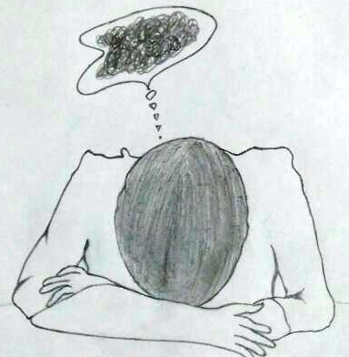
Implications of Unhappiness on Mental Health (health of the Self)
Excitement (feeling high)
Disharmony within
Stress, Tension, Frustration
Mood swings→
Manic Depression
Escape from unhappiness→
Substance abuse…
Suicide...
Depression (feeling low)
Problem is in the Self
Medicine/treatment is primarily given to the Body
(when human being is assumed to be the Body)
Notes:
16

Slide 17
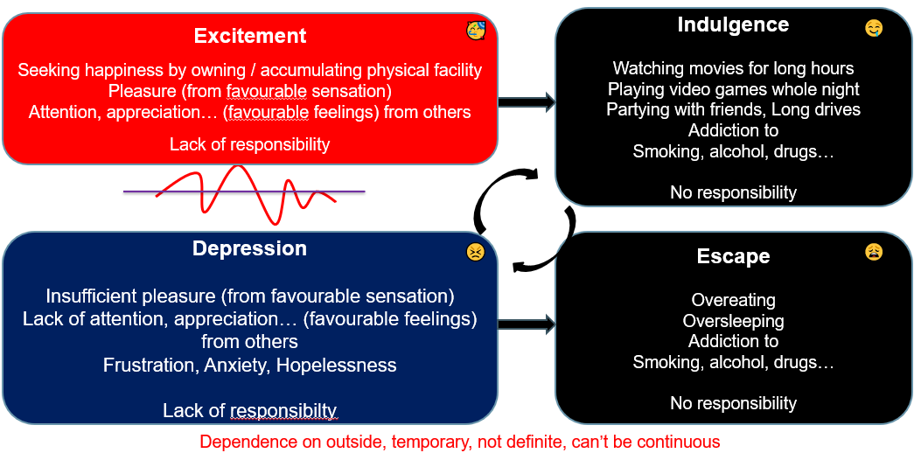
Excitement-Depression to Happiness Desired State
Happiness
Harmony
Right understanding
Right feeling
Responsibility
😊
Continuous, definite
No fluctuations
No dependence on outside

Slide 18
Excitement-Depression to Happiness Desired State
Excitement
Seeking happiness by owning / accumulating physical facility
Pleasure (from favourable sensation)
Attention, appreciation… (favourable feelings) from others
Lack of responsibility
🥳
🥳
Happiness
Harmony
Right understanding
Right feeling
Responsibility
😊
Depression
Insufficient pleasure (from favourable sensation)
Lack of attention, appreciation… (favourable feelings) from others
Hopelessness
Lack of responsibility
😣
Continuous, definite
No fluctuations
No dependence on outside
Dependence on outside, temporary, not definite,
can’t be continuous

Slide 19
Prosperity (le`f))
Prosperity – The feeling of having / producing more than required Physical Facility
le`f) & vko”;d lqfo/kk ls vf/kd dh miyfC/k@ mRiknu dk Hkko
Prosperity and Possession of Wealth are two different things
Do you want to be a billionaire or a prosperous person? Ask yourself
Are you sure that by becoming a billionaire, you are going to be happy in continuity??
A prosperous person thinks of right utilisation, nurturing the other
“ deprived “ “ “ accumulation, exploiting “ “
le`) O;fDr lnqi;ksx dk] nwljs dk iks"k.k djus dk lksprk gS
nfjnz “ laxzg “ “ “ “kks"k.k “ “ “ “

Slide 20
Basic Human Aspiration and Program for its Fulfilment
PROGRAM:
Understanding Harmony
RIGHT UNDERSTANDING
(le>)
in the self
Understanding Harmony:
Harmony in Human Being
Harmony in Family
Harmony in Society
Harmony in Nature/Existence
VALUES
1
Education –
Understanding
2
3
RELATIONSHIP (laca/k)
with human being
PHYSICAL FACILITY
(lqfo/kk)
with rest of nature
Living in Harmony
all 4 levels:
Individual
Family
Society
Nature/Existence
SKILLS
Sanskar –
Living
Living in Harmony
with human being
Living in Harmony
with rest of nature
MUTUAL HAPPINESS
(mHk; lq[k)
MUTUAL PROSPERITY
(mHk; le`f))

Slide 21
Sum Up
Self-exploration is a process of listening to the proposal, verifying on the basis of natural acceptance and validating in one's living, leading to right understanding
Basic Human Aspiration = Happiness and prosperity in continuity
Happiness = To be in a state of Harmony
Unhappiness = To be forced to be in a state of Disharmony
Happiness and Excitement are not the same – they are two different things
What we get from favourable sensation from the body or favourable feeling from others is excitement; it is temporary, indefinite, dependent on outside
Prosperity = The feeling of having / producing more than required Physical Facility
Prosperity and accumulation of wealth are not the same
The program for fulfilment of basic human aspiration is to understand harmony and live in harmony at all levels of being

Slide 22
Home Assignment

Slide 23
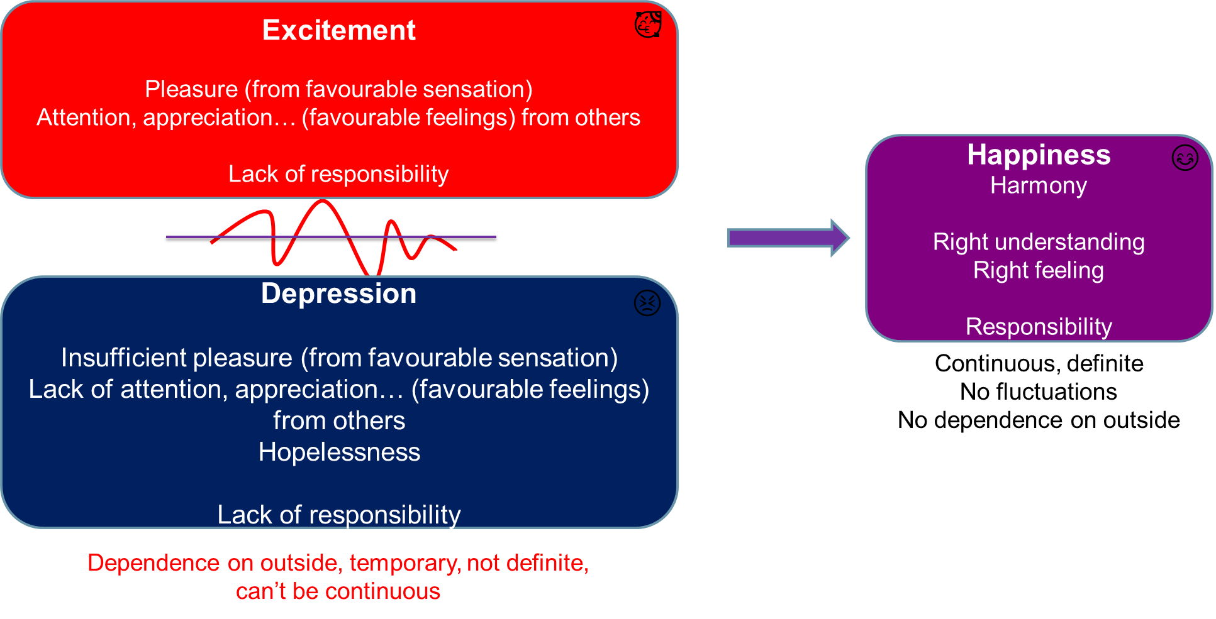
Home Assignment
4.1 List out all the programs you make during a day to make you happy. Find out if the happiness you derived from these programs is definite and continuous, or is it indefinite or short lived. Identify those programs that result in continuous happiness.
4.2 Observe the frequency of the fluctuation (change) of your feelings between excitement and depression (feeling low) during the day. Find out the reason for these fluctuations. Write down your conclusion from this exercise

Slide 24
Home Assignment
4.3 Take your list of aspirations and concerns.
Classify the aspirations into four categories:
Aspirations at the individual level. e.g., you aspire to be happy within, to be healthy
Aspirations at the level of family. e.g., you aspire to be comfortable with everyone in your family and you want them to be assured of you
Aspirations at the level of society. e.g., You aspire for a good job
Aspirations at the level of nature. e.g., You aspire for natural resources to be readily available
Classify the concerns also into these four categories:
Concerns at the individual level. e.g., you want to get rid of confusions, tension, frustration…
Concerns at the level of family. e.g., you want to overcome anger, peer pressure…
Concerns at the level of society. e.g., you wish that the domination, exploitation, differentiation and terrorism is resolved
Concerns at the level of nature. e.g., you’d like the pollution levels to reduce
In the next session, we will discuss the aspirations and concerns at the individual level.

Slide 25
Questions?

